Slide 1
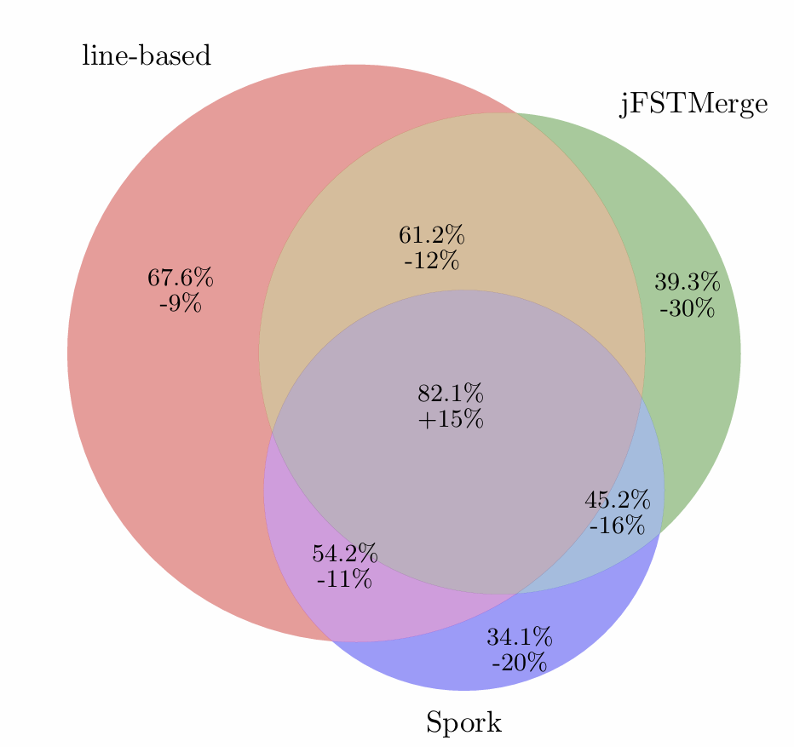
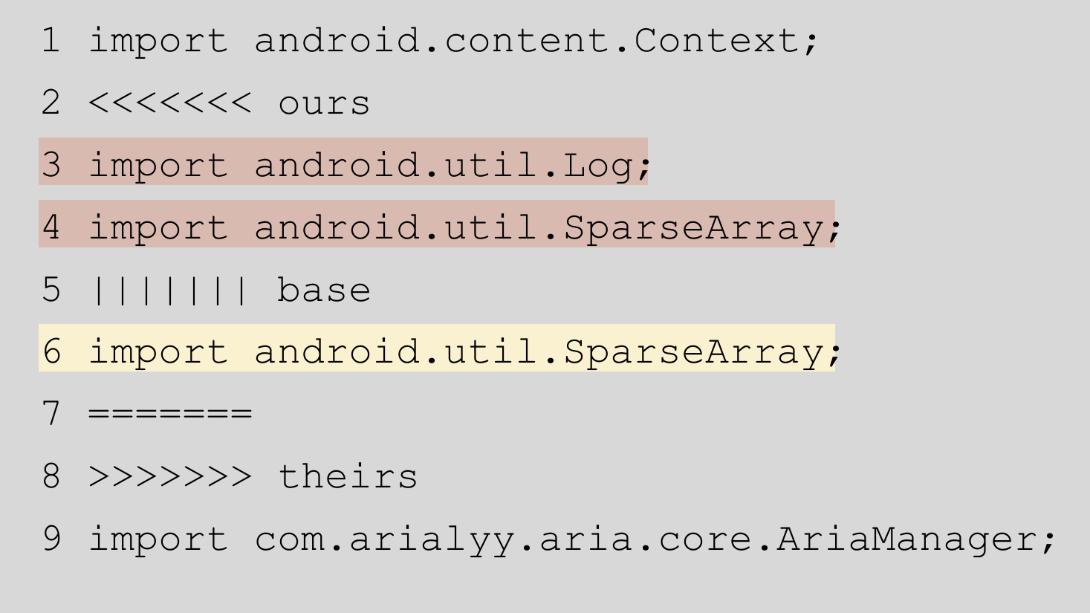
The Impact of Structure on Software Merging
Major Research Question:
What is the impact of structure (line-based vs. (semi-)structured conflict detection) on the derivability of merge conflicts?
Results from an empirical study of GitHub project histories.
Notes:
Hypothesis to be confirmed in the future: Derivability is highest if all merge conflict detectors agree that there is a conflict.

